Slide 1
RECIPE FINDER
Recipe Finder
Shashank Kumar Singh , Arya Siddarath Rao, Sandeep Bhardwaj
GLA UNIVERSITY
CEA
27-12-2023

Slide 2
introduction
A recipe finder website is a platform that allows users to search for recipes based on various criteria such as ingredients, cuisine and more.
A recipe finder typically consists of several key components that work together to provide users with a comprehensive and user-friendly cooking experience.
Welcome to Recipe Finder, your go-to resource for finding delicious recipes. Whether you're a seasoned chef or just getting started, we've got you covered!

Slide 3
objectives
The proposed system is to build an application that has a feature to search for recipes based on material owned by the user.
The system suggests recipes according to the vegetables and fruits available to the user.
User inputs the available ingredients and this application displays a list of possible recipes online.
The application is personalised , which means the recipes displayed are filtered according to the user’s preferences and health conditions

Slide 4
Problem statement
Accessibility issues : Lack of users ,so we can not test all features of website
Limited options : Many individuals struggle to find diverse recipes that suit their preferences and dietary restrictions.
Time Constraints: Busy schedules often leave people with little time to search for, plan, and prepare meals.
Lack of Inspirations : People often feel bored and uninspired by their current repertoire of recipes.

Slide 5
Literature review
Online Recipe Databases: Existing platforms provide a wealth of recipes, but they can be overwhelming to navigate.
Cookbooks : Traditional recipe books offer a physical format, but may not always cover specific dietary needs or provide real-time updates.
Social Media : Food-focused social platforms offer a vast array of recipes, but it can be tricky to find reliable sources.

Slide 6
methodology
Research : Conducted comprehensive analysis to identify key features and requirements for an effective recipe finder.
Development : Collaborated with experienced chefs and web developers to design a user-friendly interface and implement advanced search functionality
Testing : Thoroughly tested the system to ensure accurate search results and seamless user experience.

Slide 7
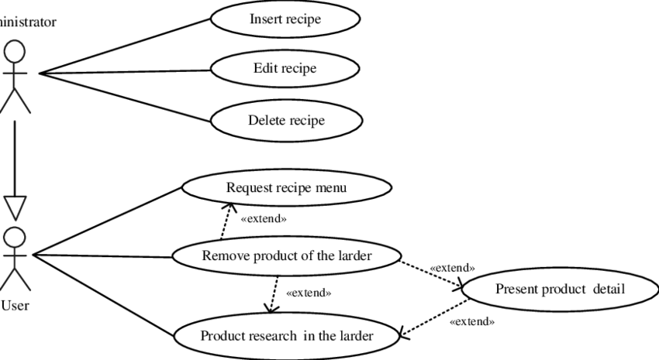
System architecture

Slide 8
implementation
Web Development : Utilized modern web technologies and frameworks to create a visually appealing and user-friendly website.
Usability Testing : Gathered feedback from a diverse group of users to optimize the website's interface and functionality.
Recipe Photography : Collaborated with professional food photographers to capture mouthwatering visuals for each recipe.

Slide 9
features
Advanced Search : Find recipes based on ingredients, cuisine, dietary restrictions, and cooking time.
Recipe Collections : Curated collections of recipes for special occasions, holidays, and specific dietary needs.
Community Interaction : Ability to rate, review, and submit recipes, fostering a sense of community and shared experiences

Slide 10
results
Through this website, we have made every effort to provide the best user experience possible. Our team has worked tirelessly to design a platform that is intuitive, user-friendly, and visually appealing.
From the moment you land on our site, you'll notice the attention to detail that we have put into every aspect. We have carefully crafted the layout, typography, and color scheme to create a seamless and enjoyable browsing experience.
Not only have we focused on aesthetics, but we have also prioritized functionality. Our website is fully responsive, meaning it adapts to any screen size, ensuring a consistent experience across devices.
Additionally, we have implemented various features and optimizations to enhance performance and loading speed. We understand that your time is valuable, so we have taken steps to ensure that our website loads quickly and efficiently.

Slide 11
Challenges faced
Data Collection : Compiling a comprehensive and accurate recipe database required extensive research and data validation.
Performance Optimization : Addressing scalability challenges to ensure smooth performance under high user load.
User Engagement : Fostering an active and vibrant user community by encouraging participation and maintaining a positive atmosphere.

Slide 12
Future work
Personalized Recommendations : Implementing machine learning algorithms to suggest recipes based on individual preferences and cooking history.
Integration with Smart Home Devices : Enabling voice-controlled recipe searches and hands-free cooking experiences.
Integration with Smart Home Devices : Enabling voice-controlled recipe searches and hands-free cooking experiences.

Slide 13
conclusion
Recipe Finder aims to revolutionize the way people discover and enjoy cooking.
With our extensive recipe collection, user-friendly interface, and interactive community, we're here to empower home chefs and make every meal a delightful experience.
Happy cooking!

Slide 14
acknowledgements
We would like to express our sincere gratitude to the talented individuals who contributed to the development of Recipe Finder. Their expertise, dedication, and passion played a crucial role in bringing this project to life.

Slide 15
Q&a
We invite you to ask any questions you may have about Recipe Finder. Our team of experts is here to provide detailed answers and assist you in making the most of our platform.

